Slide 1

A
Seminar Presentation on
“ Yolo Object Detection”
Prepared by:
Sagar Siddharth Waghmare
Roll No:-3265
Guided by:
Prof. P. D. Walunj
Academic Year- 2020-21
Department of Computer Engineering
Amrutvahini College of Engineering, Sangamner

Slide 2
Contents...
Introduction
Motivation
Objectives
Literature Survey
System Architecture
Working of YOLO
-CNN Layers:
1.Convolutional layers
2.Subsampling or Max pooling
3.Flattening
4.Fully Connected
Advantages & Disdvantages
Applications
Conclusion & Future Scope
References

Slide 3
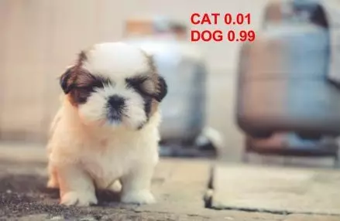
Introduction:-
YOLO is one such real-time Object detection algorithms.
Object Detection is often discussed along with Image Classification and Object Localization.
By spicing up our Convolutional Neural Network, we can repurpose its amazing classification properties to also locate where the classes are in the image.

Slide 4
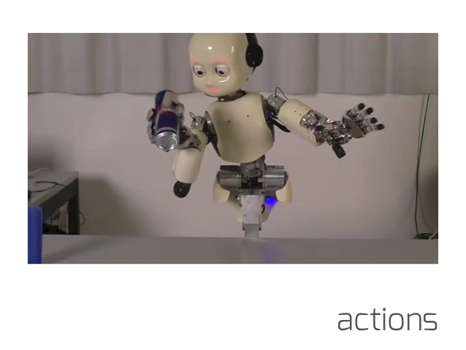
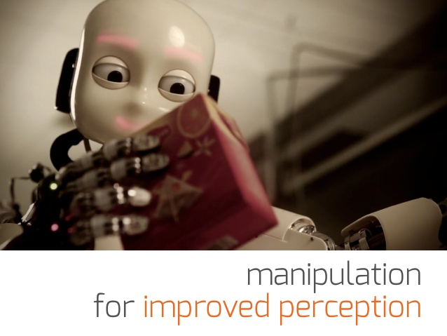
Motivation:-
To get output in which result can be altered img/ a report which is based on analysing that image.
To recognize and locate (localize) all known objects in a scene.
To give vision to computer/robot to detects and defines objects like humans doing.

Slide 5
Objectives:-
To learn and understand the basic concept of Image Processing and Deep Learning.
To learn the basics of object detection.
To learn the algorithms of image processing and Deep Learning to solve real world problems.

Slide 6
Literature Survey:-
Sr No. | Paper | Author | Work On | Advantages/Disadvantages
1 | You Only Look Once: Unified, Real-Time Object Detection | Joseph Redmon, Santosh Divvala, Ross Girshick | Prior work on object detection repurposes classifiers to perform detection. Instead, we frame object detection as a regression problem to spatially separated bounding boxes and associated class probabilities | The spatial constraint limits the number of nearby objects that our model can predict.
2 | YOLO-LITE: A Real-Time Object Detection Algorithm Optimized for Non-GPU Computers | Rachel Huang, Rachel Huang | A real-time object detection model developed to run on portable devices such as a laptop or cellphone lacking a Graphics Processing Unit (GPU). | Facing problem with large data.
3 | Object Detection Based on YOLO Network | Jiawei Liang, Kai Li, Yihang Chen | To sollve problems with images in real-world shooting such as noise, blurring and rotating jitter, etc. | The same object with small deviations in pixels caused by actual shooting may be divided into different classifications by neural networks.

Slide 7
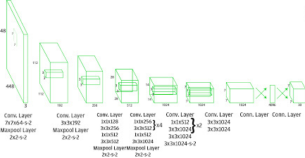
System Architecture:-

Slide 8
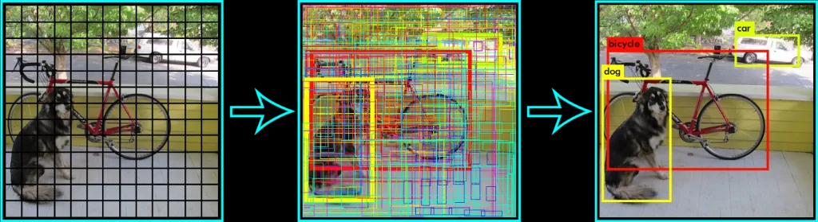
Working:-
YOLO divides the whole image into the S x S grids and each grid will be predicting B boundary boxes.
If the center of an object falls into a grid cell then that cell will be responsible for detecting that particular object.

Slide 9
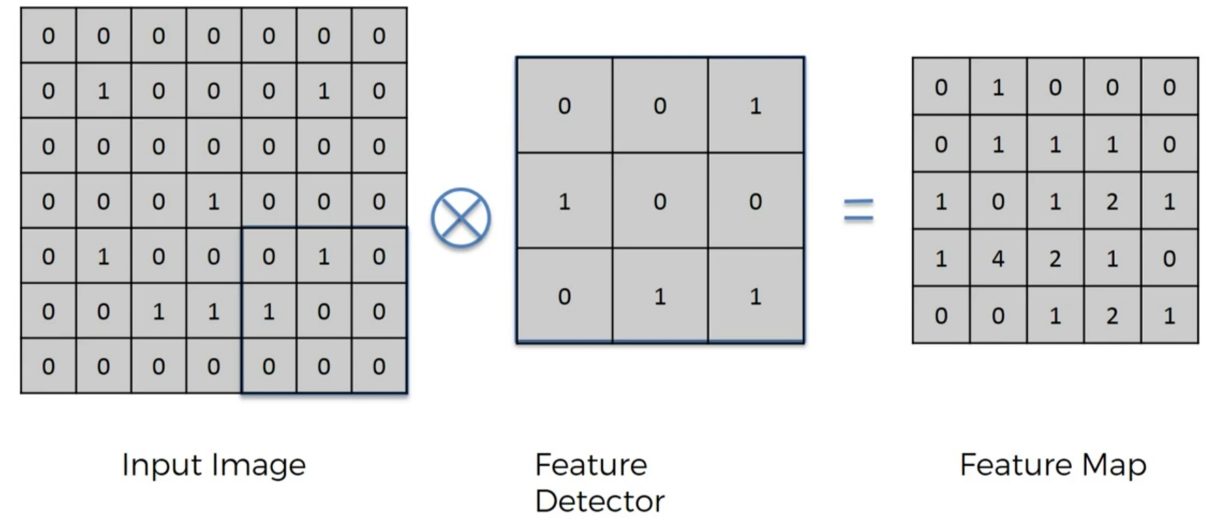
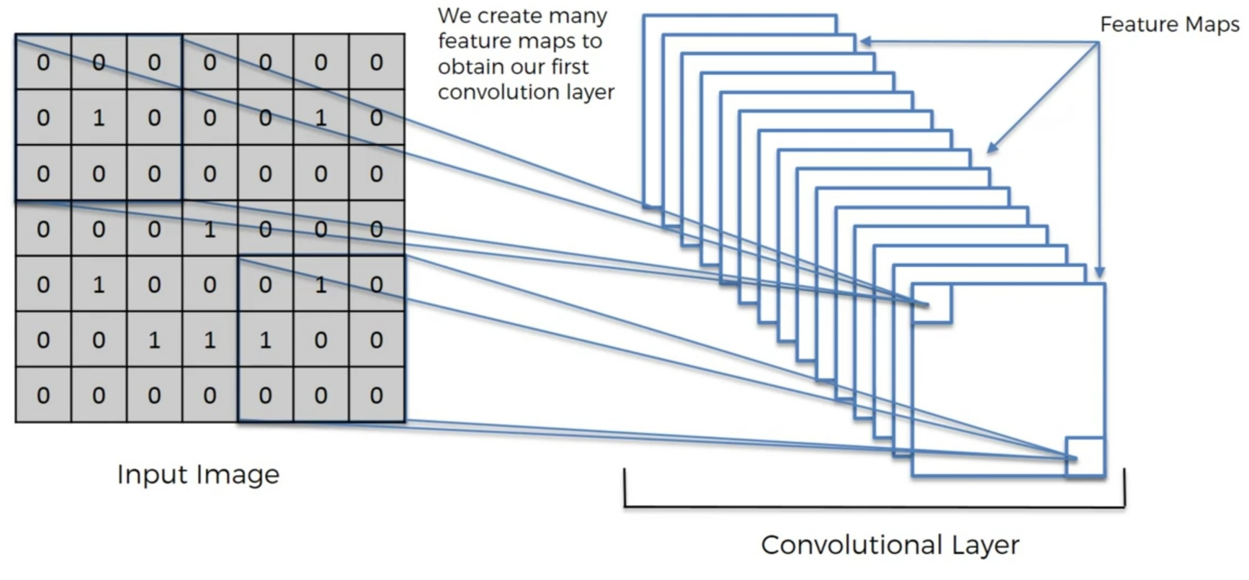
Contd.:-
Applying CNN:-
Convolutionaal Layer:-

Slide 10
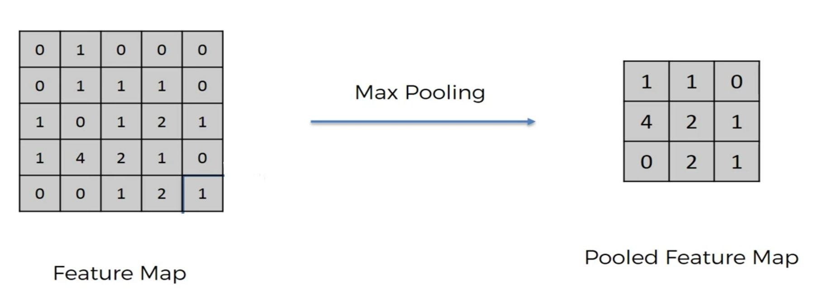
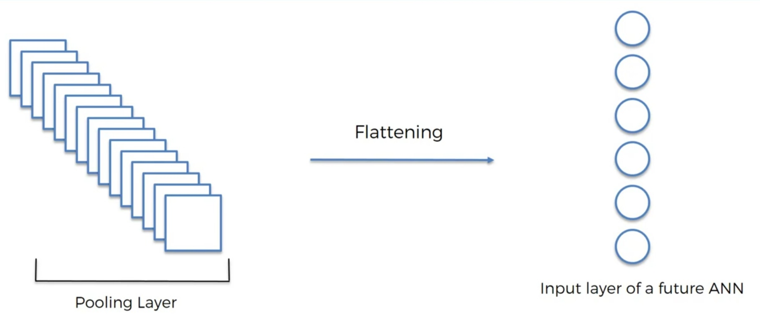
Contd.:-
Subsampling or Max pooling:-
Flattening:-

Slide 11
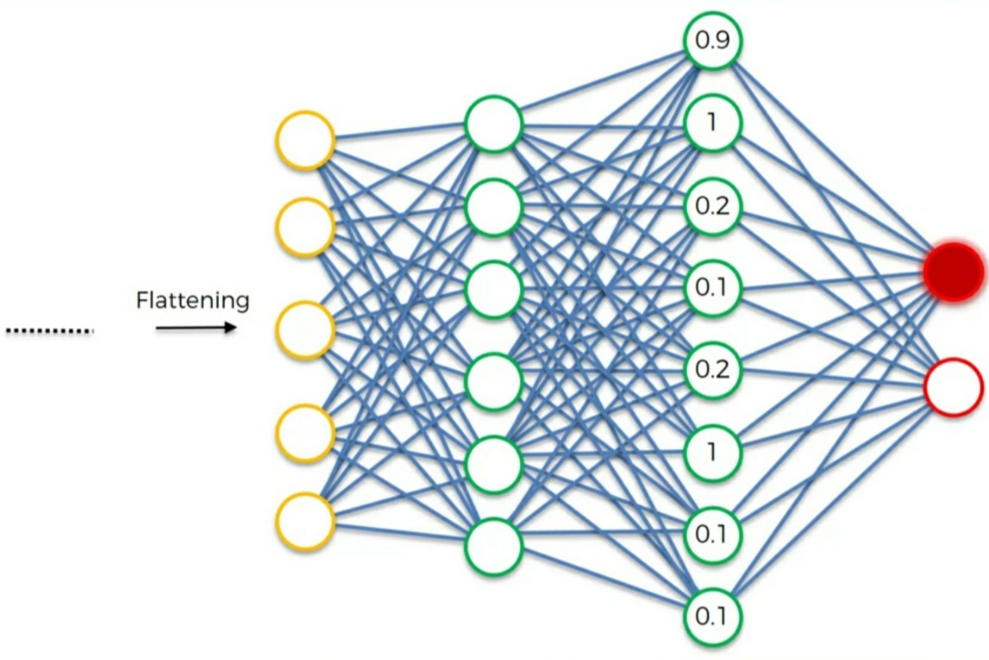
Contd.:-
Fully Connected:-
0.7%
76%

Slide 12
Summary:-

Slide 13
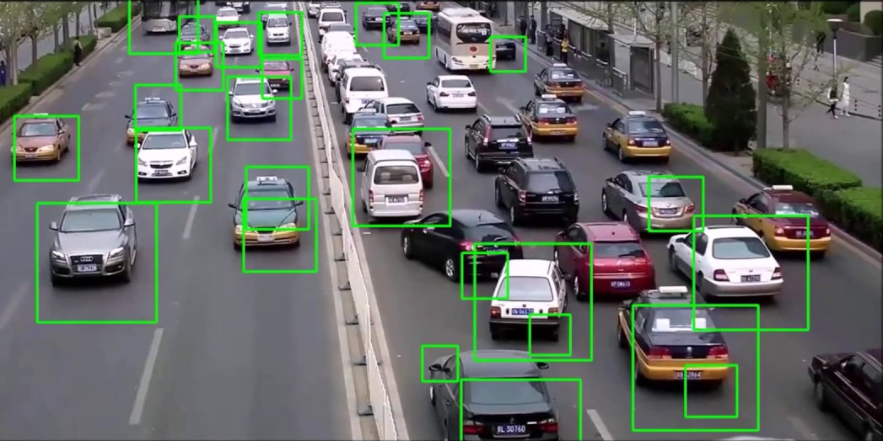
Applying Yolo on Real World Problem Example:-
Think about it – if you could integrate a vehicle detection system in a traffic light camera, you could easily track a number of useful things simultaneously:
How many vehicles are present at the traffic junction during the day?
What time does the traffic build up?
What kind of vehicles are traversing the junction (heavy vehicles, cars, etc.)?
Is there a way to optimize the traffic and distribute it through a different street?
And so on. The applications are endless!

Slide 14
Advantage:-
Faster Speed: YOLO algorithms works comparatively faster as compared to another algorithm.
It works with real time.
Faster version with smaller architecture.
Open source.

Slide 15
Disadvantages:-
Struggle with small objects.
Each grid cell predicts only one object.
YOLO also have some limitation on how close objects can be.

Slide 16
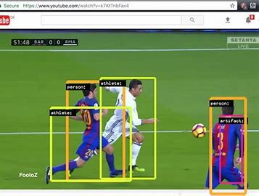
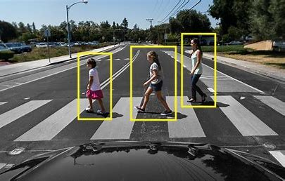
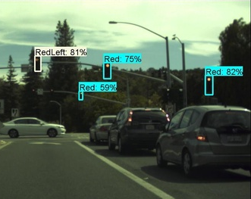
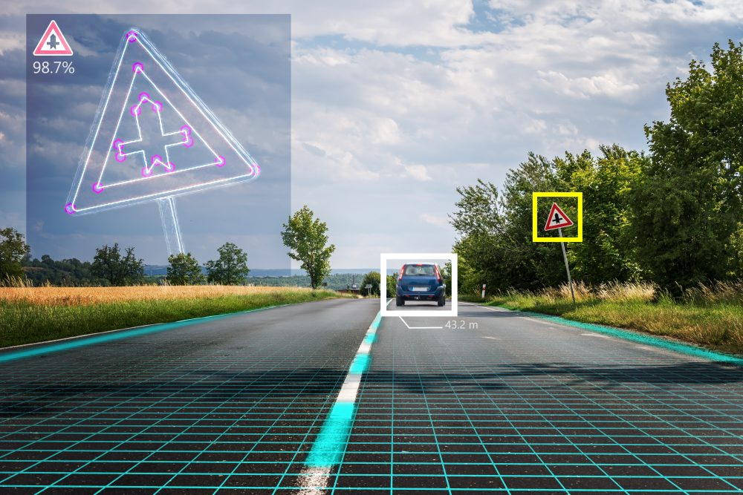
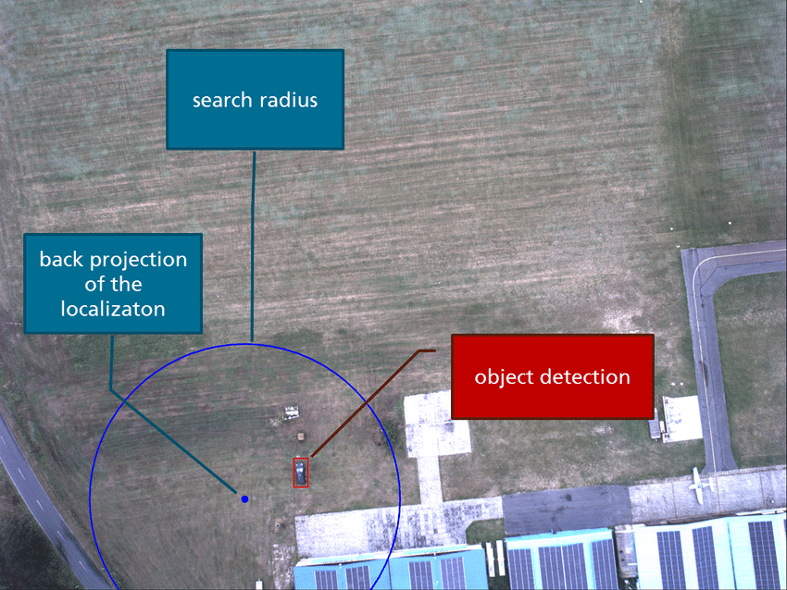
Application:-
Self driving cars
Machine/Robot Vision
Defense and Security
Image classification & Object Detection
Image recognition
Health Care Diagnostic

Slide 17
Conclusion:-
YOLO is a unified model for object detection. It is simple to construct and can be trained directly on full images. It encodes contextual information about Object classification as well as Object appearance in a single run. YOLO is the fastest general-purpose object detector in the literature. YOLO also generalizes well to new domains making it ideal for applications that relay on fast, robust & real time object detection.

Slide 18
Future Scope:-
Object-Part Relation
Pixel-Level Detection
Open-World Learning and Active Vision

Slide 19
Reference:-
Pranav Adarsh, Pratibha Rathi, Manoj Kumar,”YOLO v3-Tiny: Object Detection and Recognition using one stage improved model”, 6th International Conference on Advanced Computing and Communication Systems 2020 (ICACCS) DOI: 10.1109/I_x0002_CACCS48705.2020.9074315
Z. Chen, R. Khemmar, B. Decoux, A. Atahouet, and J. Y. Ertaud, “Real time object detection, tracking, and distance and motion estimation based on deep learning: Application to smart mobility,” 8th Int. Conf. Emerg. Secur. Technol. EST, pp. 1–6, 2019, doi: 10.1109/EST.2019.8806222.
https://thebinarynotes.com/
https://analyticsindiamag.com/

Slide 20



